Slide 1
Chapter 4
The Relational Model
Pearson Education © 2014

Slide 2
Chapter 4 - Objectives
Terminology of relational model.
How tables are used to represent data.
Properties of database relations.
How to identify CK, PK, and FKs.
Meaning of entity integrity and referential integrity.
Pearson Education © 2014

Slide 3
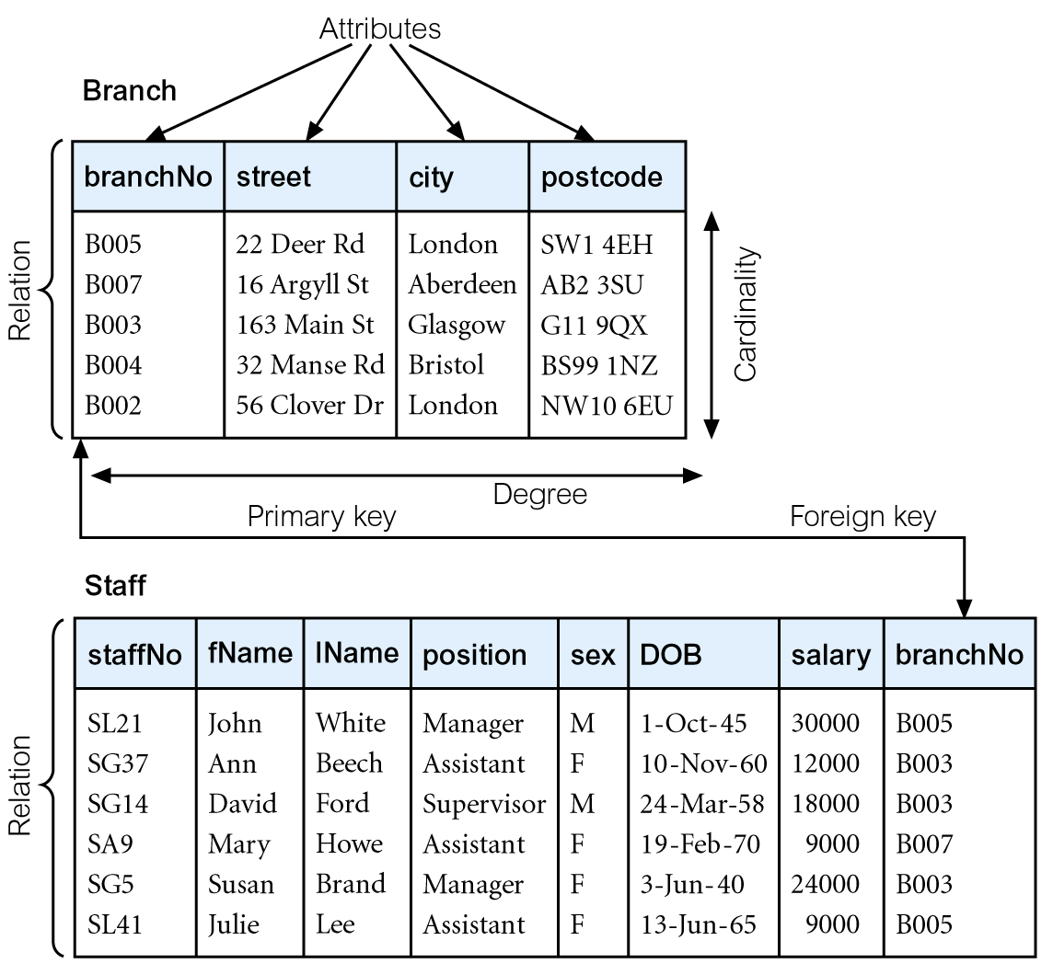
Relational Model Terminology:
Instances of Branch and Staff Relations
Pearson Education © 2014
Notes:
Entities -> Relations -> Tables
Attributes -> fields -> Columns
Entity instances -> Records/tuples -> Rows
Degree is the number of column
Cardinality is the number of records

Slide 4
Relational Model Terminology
In relational databases, data is organized as tables
Tuple (record) is a row of a relation (table).
Degree is the number of attributes (columns) in a relation.
Cardinality is the number of tuples (records) in a relation.
Relational Database is a collection of normalized relations with distinct relation names.
Pearson Education © 2014

Slide 5
Relational Model Terminology
A relation is a table with columns and rows.
  Only applies to logical structure of the database, not the physical structure.
Attribute is a named column of a relation.
Pearson Education © 2014

Slide 6
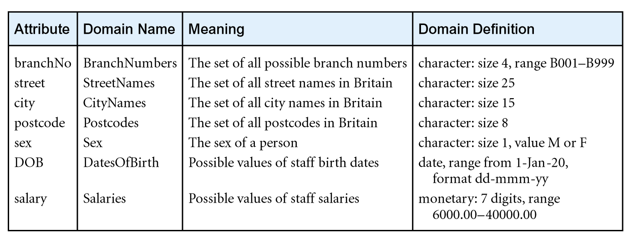
Relational Model Terminology
Domain is the set of allowable values for one or more attributes.
Examples of attribute domains:
Pearson Education © 2014

Slide 7
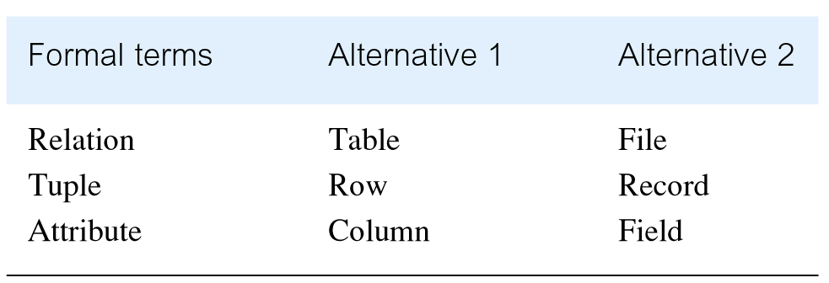
Alternative Terminology for Relational Model
Pearson Education © 2014

Slide 8
Database Relations
Relation schema
  Named relation defined by a set of attribute and domain name pairs.
Relational database schema
  Set of relation schemas, each with a distinct name.
Pearson Education © 2014

Slide 9
Schema example
A schema can be described as the list of relations (tables) and their attributes (fields):
  STUDENT(SId, SName, GradYear, MajorId)
  DEPT(DId, DName)
  COURSE(CId, Title, DeptId)
  SECTION(SectId, CourseId, Prof, YearOffered) ENROLL(EId, StudentId, SectionId, Grade)
Pearson Education © 2014

Slide 10
Properties of Relations
Relation name is distinct from all other relation names in relational schema.
Each cell of relation contains exactly one atomic (single) value.
Each attribute has a distinct name.
Values of an attribute are all from the same domain.
Pearson Education © 2014

Slide 11
Properties of Relations
Each tuple is distinct; there are no duplicate tuples.
Order of attributes has no significance.
Order of tuples has no significance, theoretically.
Pearson Education © 2014

Slide 12
Relational Keys
Cant use table row order to refer to records
Must use specific field values of a record
But not all field values are guaranteed to be unique
A superkey is a field (or fields) that uniquely identifies a record in a table, e.g., {SId}
We can add additional fields to a superkey, e.g., {SId, GradYear}
If additional fields do not add uniqueness to superkey, then field is superfluous, e.g., GradYear
A key is a superkey with no superfluous fields, e.g., {SId}
Pearson Education © 2014

Slide 13
Relational Keys
Superkey
  An attribute, or set of attributes, that uniquely identifies a tuple within a relation.
Candidate Key
  Superkey (K) such that no proper subset is a superkey within the relation.
  In each tuple of R, values of K uniquely identify that tuple (uniqueness).
  No proper subset of K has the uniqueness property (irreducibility).
Pearson Education © 2014

Slide 14
Selecting Keys
Even if field might not have duplicate values, it does not follow that it is an appropriate key
Consider SName field. No current duplicate student names, not guaranteed that there might not be in the future
Combining fields into keys can add constraints
E.g.: {StudentId, SectionId} key of ENROLL table suggests students can't enroll in same section twice
Pearson Education © 2014

Slide 15
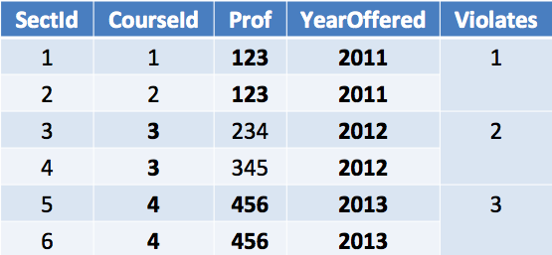
Example Constraints on SECTION Table
SECTION(SectId, CourseId, Prof, YearOffered)
{Prof, YearOffered}: professor teaches one section a year
{CourseId, YearOffered}: course has one section per year
{CourseId, Prof, YearOffered}: professor teaches one section of a given course per year
Pearson Education © 2014

Slide 16
Duplicate Records
Most RDBMS do not require tables to have keys
This means that there can be duplicate records
If so, can't modify one without modifying the other
We can not tell them apart
Consider two student records with the same field values; we could not change one record's grade without changing the other
We could not enroll one without enrolling the other as well
Pearson Education © 2014

Slide 17
Primary Keys
Primary Key
  Candidate key selected to identify tuples uniquely within relation.
  Table can have several keys, but one is designated as the primary key. Other keys are also unique, but might just be asserting constraints
  Primary key should be intuitive and is used to reference the record from other tables
  IDs are usually chosen as primary keys
  User or RDBMS can generate the IDs
Alternate Keys
  Candidate keys that are not selected to be primary key.
Pearson Education © 2014

Slide 18
Foreign Keys
Foreign Key
  Attribute, or set of attributes, within one relation that matches candidate key of some (possibly same) relation.
  MajorId in STUDENT is a foreign key of DEPT
  DeptId in COURSE is a foreign key of DEPT
  CourseId in SECTION is a foreign key of COURSE StudentId in ENROLL is a foreign key of STUDENT
Pearson Education © 2014

Slide 19
Schema Nomenclature
TABLE_NAME(PrimaryKey, Fields, ForeignKey)
STUDENT(SId, SName, GradYear, MajorId) DEPT(DId, DName)
COURSE(CId, Title, DeptId)
SECTION(SectId, CourseId, Prof, YearOffered) ENROLL(EId, StudentId, SectionId, Grade)
Pearson Education © 2014

Slide 20
Keys and their Foreign Keys
The connection between a key and foreign key works in both directions
Given a student record we can use the department foreign key to find the corresponding department record
The relation works in the other direction as well; given a department, we can find out all the students for that department
Pearson Education © 2014

Slide 21
Integrity Constraints
Null
  Represents value for an attribute that is currently unavailable, unknown or not applicable for tuple.
  Represents the absence of a value and is not the same as zero or spaces, which are values.
  f field in record is Null then operations on record based on Null field will not participate in operation
    If some records have Null GradYear, then they cant be counted or compared
    Cant determine whether Null GradYear is equal, greater, or less than another record's Grad
Pearson Education © 2014

Slide 22
Integrity Constraints
Entity Integrity
  In a base relation, no attribute of a primary key can be null.
Referential Integrity
  If foreign key exists in a relation, either foreign key value must match a candidate key value of some tuple in its home relation or foreign key value must be wholly null.
Pearson Education © 2014

Slide 23
Integrity Constraints
Entity Integrity
  In a base relation, no attribute of a primary key can be null.
Referential Integrity
  If foreign key exists in a relation, either foreign key value must match a candidate key value of some tuple in its home relation or foreign key value must be wholly null.
Pearson Education © 2014

Slide 24
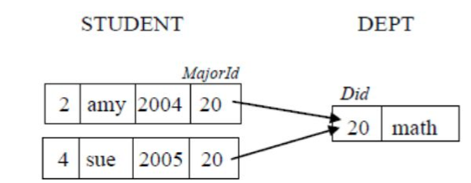
Enforcing Referential Integrity
The following actions would violate referential integrity and would be disallowed
  Modifying Did
  Deleting the math department
  Modifying MajorId to a non existing Did
  Inserting new STUDENT record with no MajorID
Pearson Education © 2014

Slide 25
Integrity Constraints
If we delete the math department we could do:
  modify foreign keys to another department or NULL
  delete the students (less appropriate)
Consider ENROLL records referencing STUDENT records. If we delete a STUDENT record, it is appropriate to cascade delete ENROLL record
If we change/update the DEPARTMENT Did then it makes sense to cascade update the foreign keys in STUDENT referencing the departments
Database can be configured to do what is more appropriate
Pearson Education © 2014

Slide 26
Creating Tables in MySQL
CREATE TABLE STUDENT (
SId int PRIMARY KEY,
SName varchar(10) not null,
MajorId int,
GradYear int,
CONSTRAINT studentFK
foreign key (MajorId) references DEPT
on update cascade
on delete set null
)
Pearson Education © 2014

Slide 27
Integrity Constraints
General Constraints
  Additional rules specified by users or database administrators that define or constrain some aspect of the enterprise.
Pearson Education © 2014

